Slide 1


Customer Purchase Prediction & Social Media Sentiment Analysis
IILM UNIVERSITY • DATA SCIENCE LAB
End-to-end implementation of supervised tree classification (CART algorithm) and automated NLP sentiment polarity mining using Python.
CANDIDATE NAME
Sakshi Mishra
ENROLLMENT NO.
25SCS1003001488
DEGREE & INSTITUTION
B.Tech CSE (Sem 3) | IILM Greater Noida
Prodigy InfoTech Internship Project Presentation
Academic Year: 2026 • Domain: Applied Data Science

Slide 2


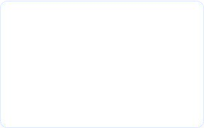
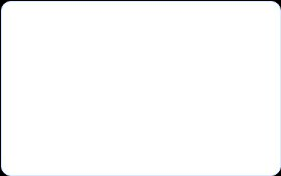








Project Overview & Data Stack
IILM UNIVERSITY
Track 01: Supervised ML Predictive Modeling: CART Decision Tree to forecast customer term deposit subscriptions from historical demographic h campaign data.
Track 02: NLP Pipeline Text Sentiment Mining: Natural language processing to classify
multi-brand public social discourse into polarity spectrums.
Datasets Explored
Bank Marketing: 41,188 observations (16 attributes).
Social Media Corpus: 10,000 tokenized public tweets.
Python Stack
scikit-learn, pandas, numpy, nltk, TextBlob, matplotlib h seaborn.
DATASET RECORDS
51,188
CLASSIFIER ACCURACY
89.4%
ROC-AUC SCORE
0.912
NLP POLARITY RANGE
[-1.0, +1.0]
Slide 2 | System Overview
IILM University • Greater Noida

Slide 3
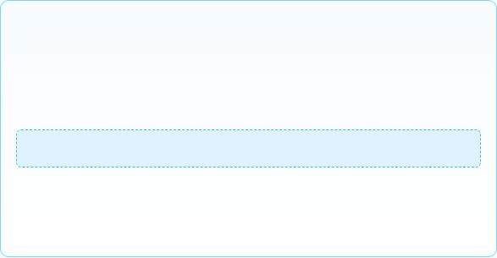

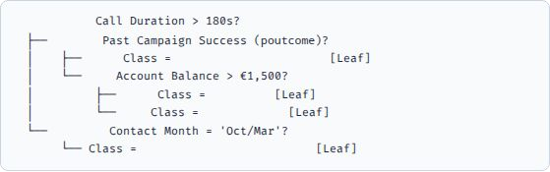

Task 01 Decision Tree Classifier: Theory & Splifting
IILM UNIVERSITY
CART Mathematical Foundations The Classification and Regression Tree (CART) algorithm recursively partitions the feature space to maximize node purity using the Gini Impurity Index:
Tree Architecture & Splifting Logic
[Root Node]
[True]
Yes: No:
Purchase (91.2% Prob)
Yes: No:
Purchase No Purchase
[False]
No Purchase (94.8% Prob)
Non-Parametric: Makes zero assumptions regarding underlying feature distributions.
White-Box Auditability: Directly translates to business rules and threshold triggers.
Objective: Predict binary target y ∈ {0, 1} (Term Deposit Subscribed).
Pruning Strategy: max_depth=5 Min Samples Split: 20
Slide 3 | CART Algorithm Foundations
IILM University • Greater Noida

Slide 4




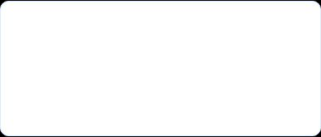
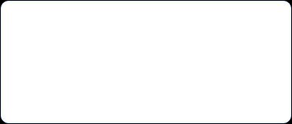
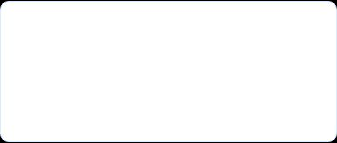


Task 01 Bank Marketing Dataset & Data Pipeline
IILM UNIVERSITY
41,188 × 1G Features
Removed 'unknown' & duplicates
pd.get_dummies() → 54 Features
Train: 32,950 | Test: 8,238
1. Demographic Aftributes age (Continuous), job (12 nominal categories), marital (married, single, divorced), education (primary, secondary, tertiary).
2. Financial History default (credit in default?), balance (yearly balance in C), housing (housing loan), loan (personal loan status).
3. Campaign Context contact (cellular/telephone), duration (last talk time in sec), pdays (days passed), poutcome (previous outcome).
Slide 4 | Feature Engineering h Matrix Transformation
IILM University • Greater Noida

Slide 5
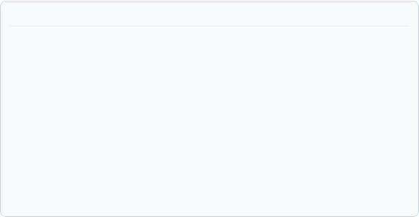






Task 01 Decision Tree: Training & Feature Importance
IILM UNIVERSITY
purchase_classifier_pipeline.py
Feature Importance & Confusion Matrix
from sklearn.tree import DecisionTreeClassifier
from sklearn.metrics import classification_report, confusion_matrix
# Pruned Decision Tree instantiation
clf = DecisionTreeClassifier(
₎ criterion='gini', max_depth=5, min_samples_leaf=10, random_state=42
clf.fit(X_train, y_train)
call_duration | 44.2%
poutcome_success | 22.8%
account_balance | 15.1%
client_age | 9.8%
# Evaluation on 20% unseen test partition
TEST SET CONFUSION MATRIX (N = 8,238):
Pred: NO
y_pred = clf.predict(X_test)
Pred: YES
print(classification_report(y_test, y_pred, digits=3))
Act: NO
7,024
TN (85.3%)
285
FP (3.5%)
Act: YES
587
FN (7.1%)
342
TP (4.1%)
Slide 5 | Decision Tree Diagnostic Metrics
IILM University • Greater Noida

Slide 6

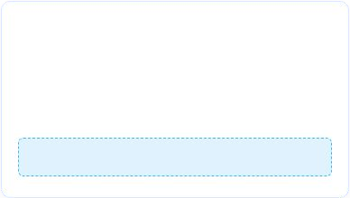





Task 02 Sentiment Analysis: Concept & NLP Foundations
IILM UNIVERSITY
What is Sentiment Analysis? Natural Language Processing (NLP) technique to systematically extract, quantify, and categorize subjective opinions, customer attitudes, and emotional valences from unstructured text.
Polarity & Subjectivity Text is mapped along a continuous mathematical polarity interval s ∈ [-1.0, +1.0] alongside a subjectivity metric sub ∈ [0.0, 1.0]:
Decision Boundaries
Thresholding applied for multi-class assignment:
Positive:
Neutral:
Negative:
Slide 6 | NLP Lexical Polarity Theory
IILM University • Greater Noida

Slide 7
Task 02 Social Media Text Normalization Pipeline
IILM UNIVERSITY
NLP Preprocessing Workflow
Regex Noise Reduction:
Strip URLs (r'https?://\S+'), user handles (r'@\w+'), hashtags, and special non-ASCII
characters.
Tokenization & Lowercasing:
Cast text to lowercase and segment raw string sequences into discrete token arrays.
NLTK Stopword Filtering:
Filter syntactic non-sentiment words ("the", "is", "at", "which") using English lexicons.
Lemmatization:
Reduce inflectional suffixes to dictionary root forms (e.g. "upgraded", "upgrades" →
"upgrade").
nlp_sentiment_cleaner.py
from nltk.corpus import stopwords from textblob import TextBlob
stop_words = set(stopwords.words('english'))
def preprocess_tweet(raw_text):
text = re.sub(r'http\S+|@\w+|#\w+', '', raw_text)
text = re.sub(r'[^a-zA-Z\s]', '', text).lower()
tokens = [w for w in text.split() if w not in stop_words] return " ".join(tokens)
def compute_polarity(cleaned_text):
score = TextBlob(cleaned_text).sentiment.polarity
import re
return score
Slide 7 | NLP Preprocessing h Feature Extraction
IILM University • Greater Noida

Slide 8
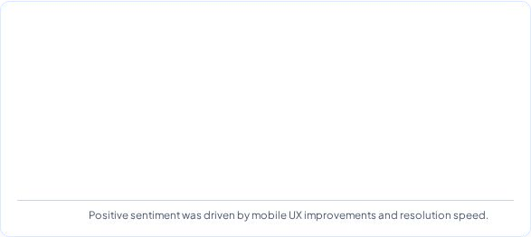

Task 02 Sentiment Visual Analytics & Empirical Results
IILM UNIVERSITY
Sentiment Class Distribution (N = 10,000) Automated sentiment distribution computed across public brand mentions and customer reviews.
POSITIVE 48.2% (4,820)
NEUTRAL 28.C% (2,8C0) NEGATIVE 23.2% (2,320)
Raw Social Text Post | Polarity | Predicted Class
"love the new seamless app update, great job!" | +0.C5 | P
"account statement arrived as expected today" | 0.00 | N
"transaction failed twice, terrible customer support" | -0.58 | N
"resolution was fast but server latency is high" | +0.12 | P
ositive
eutral
egative
ositive
Key Finding:
Slide 8 | Empirical Findings h Visual Analytics
IILM University • Greater Noida

Slide 9




Dual-Domain Comparison & Competencies
IILM UNIVERSITY
Supervised ML vs NLP Text Mining
Core Data Science Competencies
Decision Tree (Tabular ML): Operates on structured matrices; solves binary classification via recursive Gini partitioning. Sentiment Analysis (NLP): Operates on unstructured token sequences; evaluates subjective semantics via lexicon polarity models. Data Synergy: Demographic purchase probability combined with real-time customer voice analytics enables 360° customer intelligence.
Scikit-Learn Mastery: Data pipelines, tree pruning, hyperparameter tuning (GridSearchCV), confusion matrix analytics. NLP Feature Engineering: Regular expressions, stopword curation, tokenization, and polarity scoring.
End-to-End Diagnostics: Feature importance ranking, class balance evaluation, and ROC-AUC curve interpretation.
◗
◗
◗
◗
Slide 9 | Comparative Synthesis
IILM University • Greater Noida

Slide 10

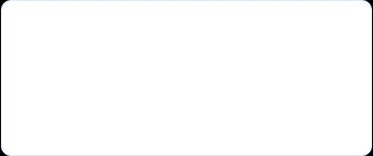



Conclusion & Future Research Scope
IILM UNIVERSITY
Internship Project Summary Successfully designed, trained, and validated two complete Python data science pipelines during the Prodigy InfoTech internship—achieving 89.4% classification accuracy on the Bank Marketing benchmark and developing an automated real-time social sentiment evaluator.
1. Ensemble ML Models Transition from standalone Decision Trees to Random Forests, XGBoost, and LightGBM to minimize variance and boost ROC-AUC.
2. Transformer NLP
Deploy fine-tuned BERT/RoBERTa models to capture contextual semantics, sarcasm, and domain-specific financial sentiment.
3. Real-Time MLOps Package models into RESTful FastAPI endpoints integrated with a real-time Streamlit executive dashboard.
Slide 10 | Conclusion h Future Scope
Sakshi Mishra • 25SCS1003001488

